Slide 1
Studies of Quantum Dots using Neural Networks and Coupled Cluster

Slide 2
Studies of Quantum Dots using Neural Networks and Coupled Cluster
System we want to solve:
Quantum Dots - Trapped electrons
Methods we will use to solve it:
Hartree-Fock
Coupled Cluster
Variational Monte Carlo (VMC) - Hartree-Fock + Neural Network

Slide 3
Goals
Implement the restricted Hartree-Fock method, the general Hartree-Fock method, the coupled cluster doubles method, and the coupled cluster singles and doubles method
Implement a variational Monte Carlo code combining the Hartree-Fock solution with a neural network
Make the code really fast

Slide 4
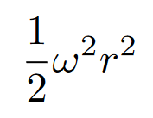
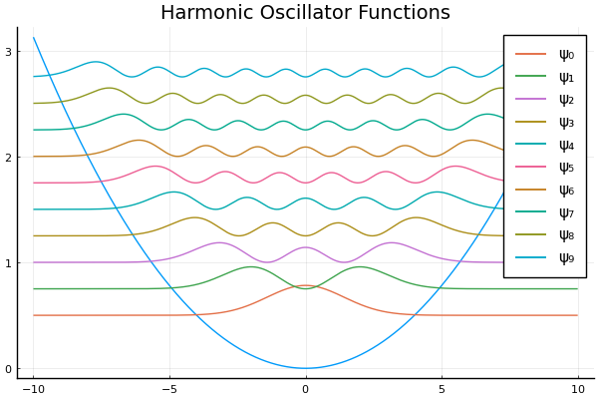
Quantum Dots
Electrons in a Harmonic Potential - Potential pulls - Electrons repel
Approximates other potentials
Non-interacting case has exact analytical solution

Slide 5

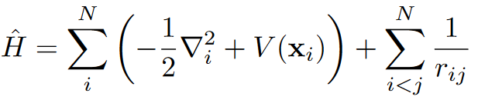
The Equation we want to solve
The time-independent electronic Schrödinger equation
The variational method - Trial wave function - Optimization

Slide 6
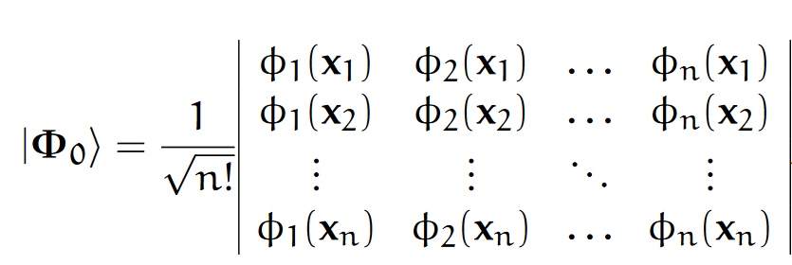
The Hartree-Fock Method
Slater determinant
Anti-symmetric
Combinations of Harmonic Oscillator functions
Optimize with iterative scheme

Slide 7

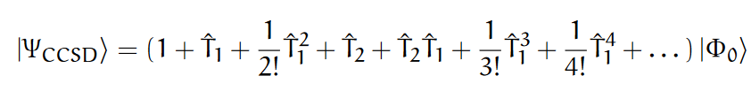




Coupled Cluster
Many Slater determinants
Using just a few operators
Not variational

Slide 8
Variational Monte Carlo
Efficiently approximate integrals
Moving particles around, following some statistical rules
Derivative of the energy -> Minimize energy
Trial wave function must have: - Output - Derivative - Double derivative - Derivative wrt. parameters
Anti-symmetric for fermions

Slide 9
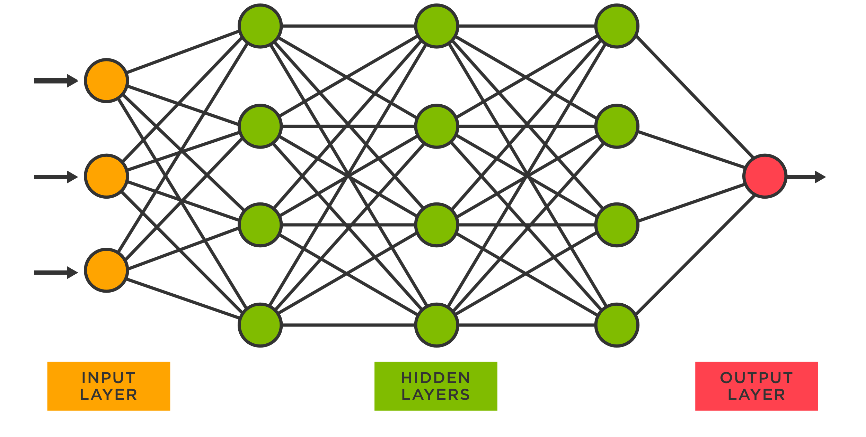
Neural Networks
Very flexible function
The universal approximation theorem - «Can approximate any continuous function»
Many parameters
Not anti-symmetric

Slide 10

The trial wave function
The Slater-Neural Network wave function
Hartree-Fock determinant - Anti-symmetric - Good starting point
Neural Network with sorted inputs - Symmetric - Flexible
1D!

Slide 11
Similar approaches by others
Even Nordhagen, Martin Krokan Hovden, Johan Nereng, Bendik Samseth: - Simple determinant - Neural Network, sorted input - Restricted Boltzmann Machine - Slater-Jastrow or Pade-Jastrow factor
FermiNet - Main Innovation: The construction of a set of permutation-equivariant functions with neural networks - Particle distances

Slide 12
Implementation
C++? - Compiled - Runtime seperate
Python? - Slow runtime - Numba and Jax
Julia - Compiles just in time - Write and run in tandem - Libraries and tools for code optimization

Slide 13
General Optimizations
1 million VMC steps takes 0.59 seconds
Paralellization - 1.88 seconds with 1 thread instead of 12
Type safety and annotations - 0.85 seconds with no type annotations on dense layer
Avoiding allocations. - 1.13 seconds with no pre-allocation in neural network forward pass
Evaluate, Derivative, Double Derivative, Parameter Derivative
Sampling, Potential Energy, VMC step calculations
Position Updating, Sorting, Gradient Updating

Slide 14
Optimizations of algorithms
Two-body integrals optimization - ~ 2 times faster than implementation by my co-supervisor - Julia ~40 times faster than Numba
Recursive Harmonic Oscillator functions - ~ 4 times faster than direct
Smart sorting of positions (and setting up un-sorting) - O(n) instead of O(n log(n)) - ~10 times faster for 2 electrons, ~50 times faster for 100

Slide 15
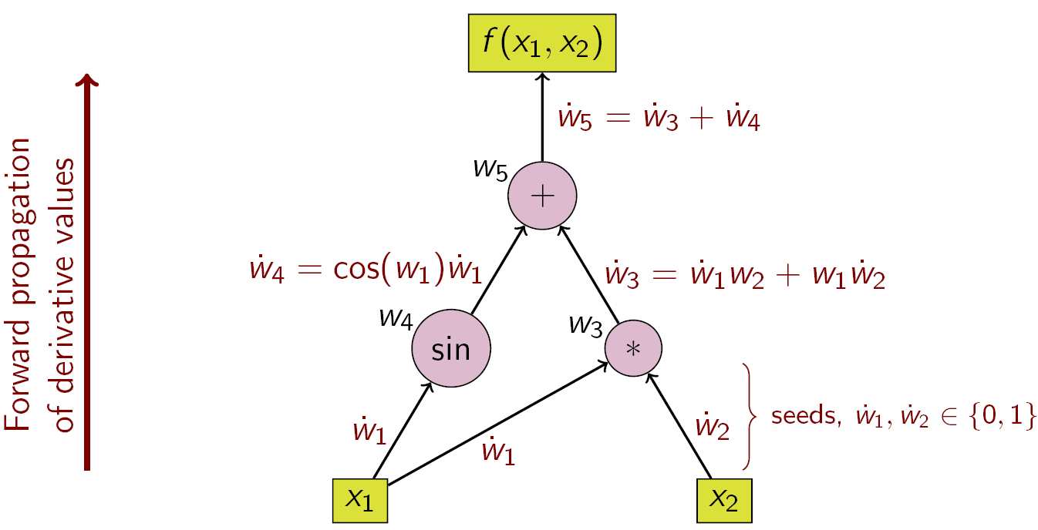
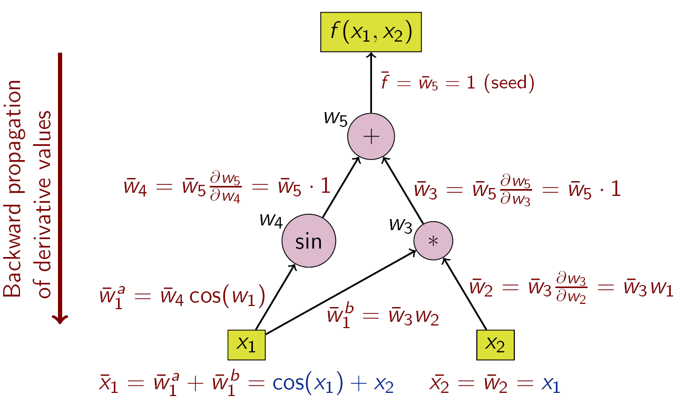
Automatic differentiation
Many calculations only consist of (+, -, *, /, sin, cos, exp, etc.)
Chain rule
Forward mode: Derivative of everything wrt. the input
Reverse mode: Derivative of the output wrt. everything (Backpropagation)

Slide 16
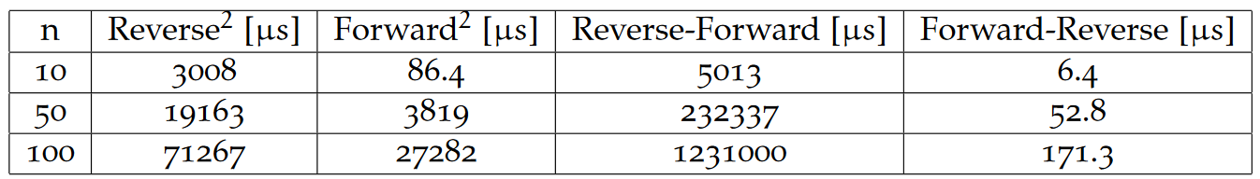
Second derivatives
Kinetic energy
Analytical for simple models
Autodiff for complicated models - Can be slow
1. derivatives using ReverseDiff, ForwardDiff of the ReverseDiff for 2.
FermiNet

Slide 17
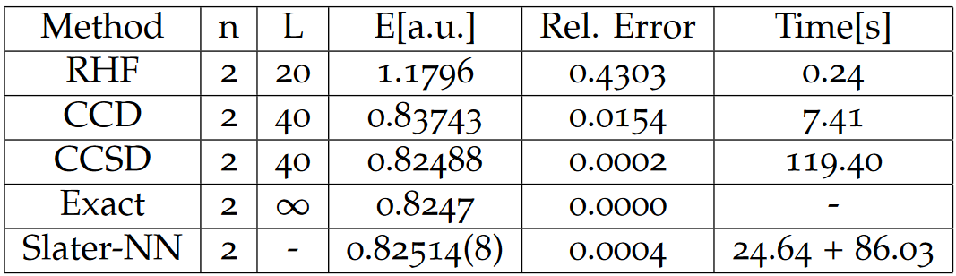
Ground state energies
HO-Slater-RBM?
HO-Slater-NN?
FermiNet?

Slide 18
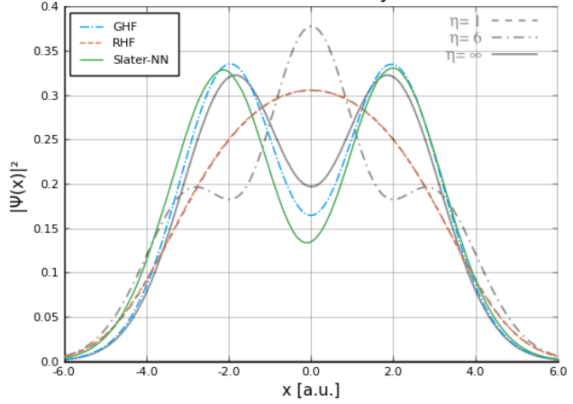
Particle density

Slide 19
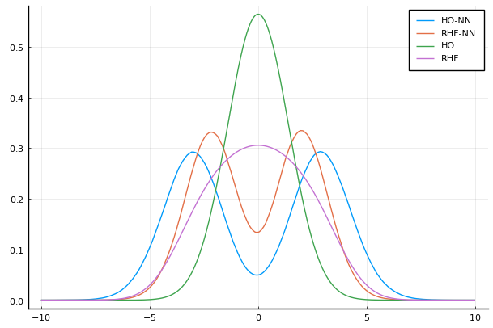

Slide 20
Conclusion and perspectives for future work
Combined Hartree-Fock determinant with a neural network
Several optimizations of the method
Shown the feasibility of using autmatic-differentiation for the double derivatives
Implemented several other many-body methods in Julia
The use of particle distances to satisfy cusp conditions
The use of permutation-equivariant functions to achieve anti-symmetry in higher dimensions
Testing on more systems

